Slide 1
How does Socioeconomic Status impact Overall Health? Looking at NHANES 2017-2018 Participants Aged 18-25
By: Oskar Eisgruber, Stephanie Erickson, and
Aidan Pinto

Slide 2
Agenda
Motivation
Data
Empirical Model
Limitations
Conclusions & Next Steps

Slide 3
Motivation

Slide 4
Previous studies have shown that socioeconomic status (SES) has a large influence on overall health
Healthy Lifestyle = behavioral patterns
Exercise
Diet
Risks - smoking, alcoholism, sedentary
Lifestyles can be passed down
Lifestyle limited by SES
Access to gyms, training facilities
Amount of time spent on leisure vs. working
Cost of healthy items → possible hunger-obesity paradox
Notes:
Our research question was motivated by previous studies showing the link between health and socioeconomic status. Previous studies have shown a link between lifestyle behavioral patterns such as exercise, diet, and other risk behaviors and ses. They were hypothesized to be caused by a number of variables such as access to gyms or sports teams, the amount of time spent relaxing or exercising versus working a second job, and the cost of a healthy diet. Since our lifestyle may be limited by SES, and lifestyles can be passed down, we chose to investigate this relationship between SES and health, focusing on three main areas of nutritional health, physical health, and mental health.

Slide 5
Data

Slide 6
Background:
National Health and Nutrition Examination Survey
Logistics
Why we chose NHANES
Population survey run by the CDC every other year
large sample size which is meant to be representative of the US population
Includes a survey and health examination
Since NHANES has such a wide population we were able to narrow our data to our population of interest and to our specific variables
Representative of the US

Slide 7
Methods:
National Health and Nutrition Examination Survey
Data Cleaning
Our Focus
Filter to 18-25 years
removing extreme outliers in variable responses
removing non responses or unknown responses
Focus on college aged participants
It is around this age we begin making our own lifestyle choices
For many, this age range includes college, first real job, and moving out

Slide 8
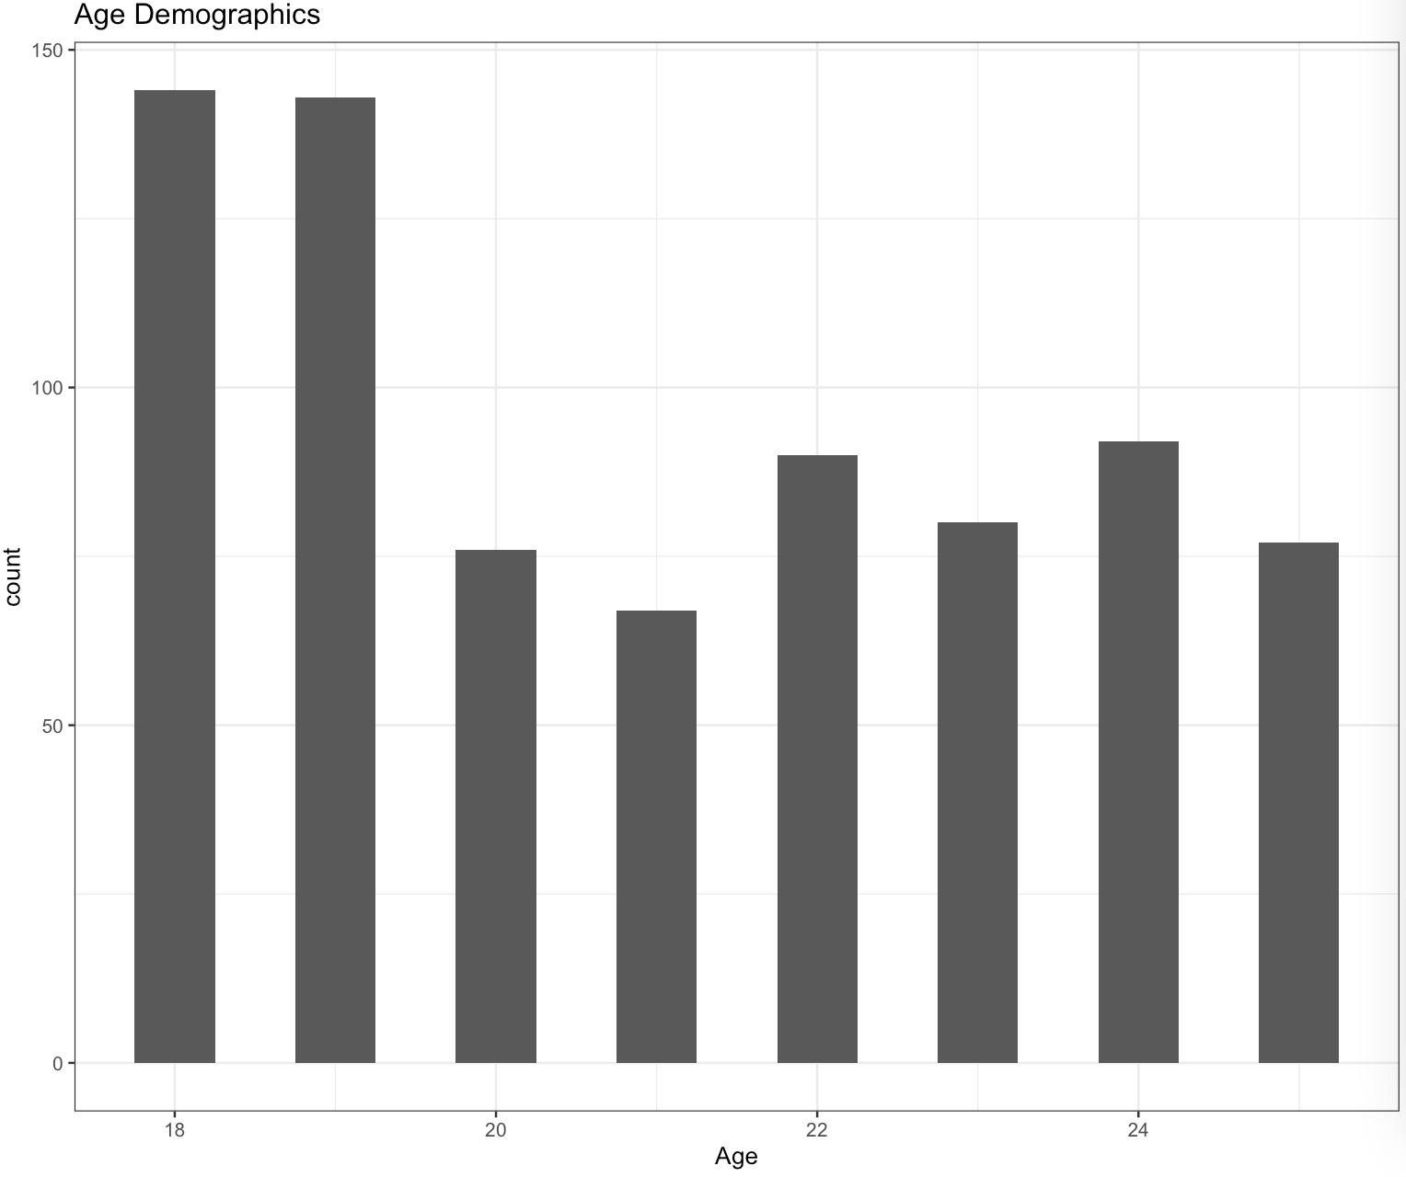
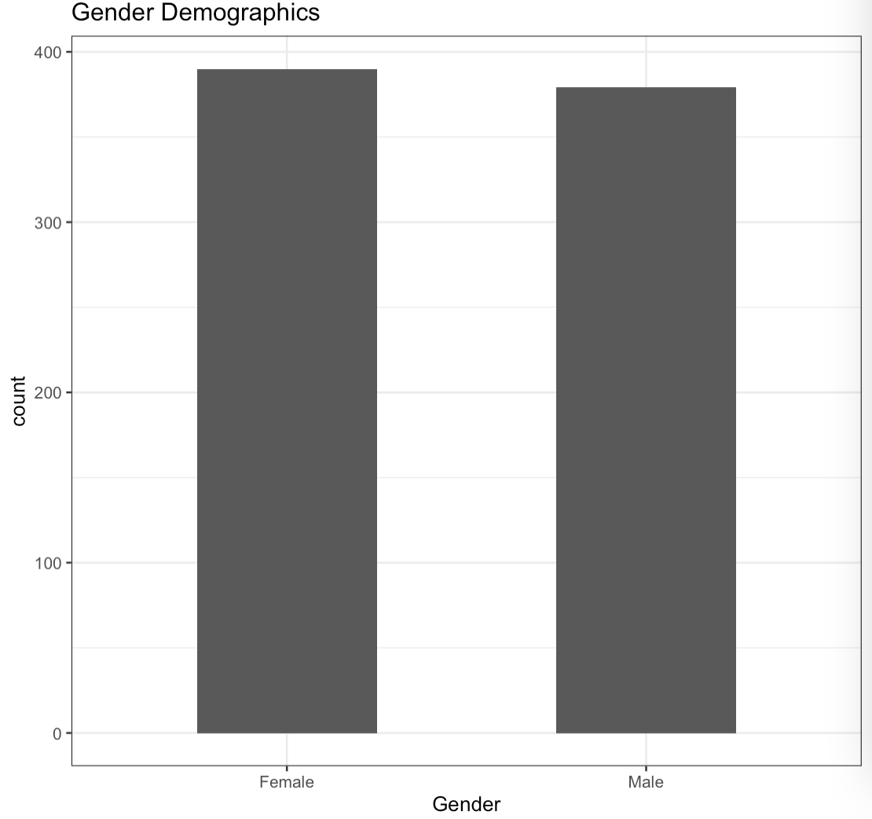
insert summary tabless...can we make them in excel?
Demographic Summary

Slide 9
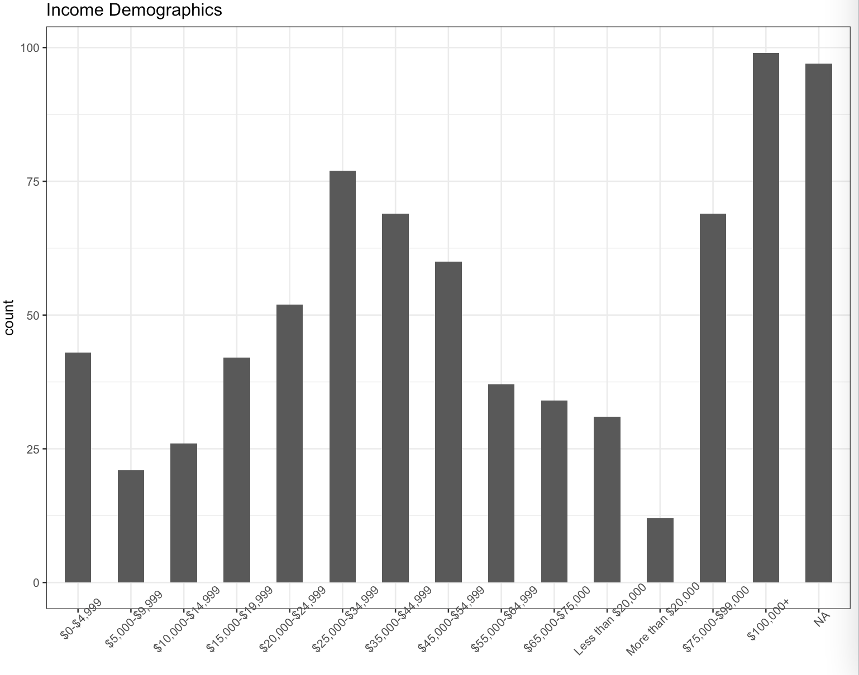

Slide 10
Analyses
Nutrition
1.
Physical Activity
2.
Mental Health
3.
Stephanie Erickson
Aidan Pinto
Oskar EIsgruber

Slide 11
Empirical Models

Slide 12
Nutrition

Slide 13
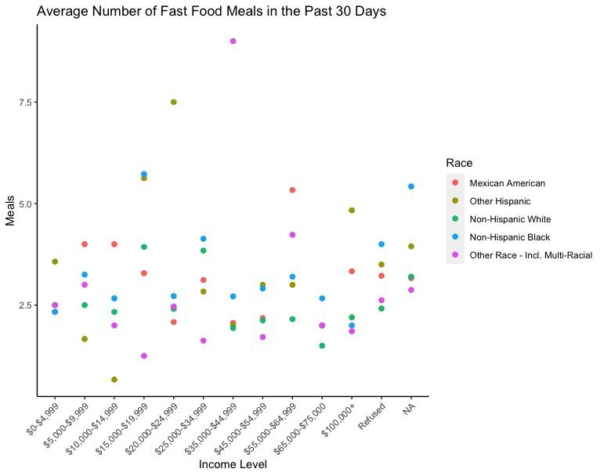
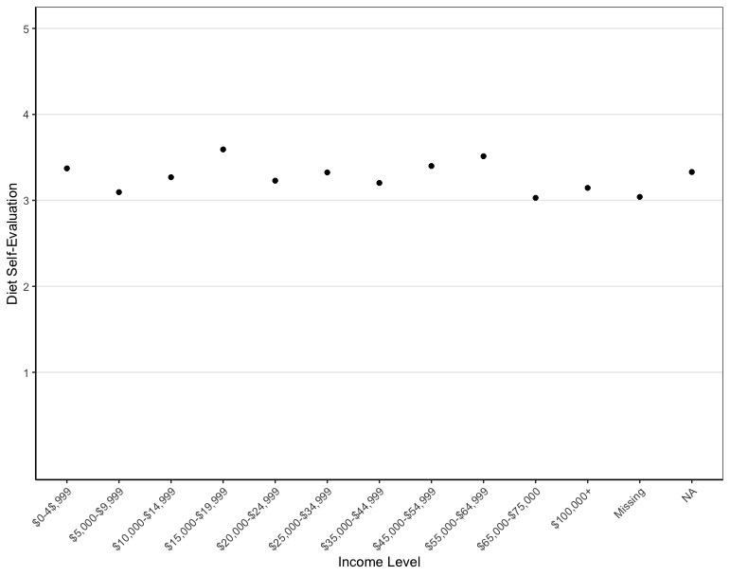
Overall, people viewed themselves as “equally healthy” across income levels
No clear trends related to eating habits
Notes:
However, also important to note that we did not find relation between thinking diet is unhealthy and eating more fast food, so people’s perception of their diet may not be an accurate reflection of their health.

Slide 14
Models show nutritional data
not heavily related to income or race
Ran variety of models, most showed no significant coefficients or relationships between nutritional variables and race/ income, relates to no clear obesity trends
Self-health evaluation by Race
Multi/ other racial group rated themselves -.444 lower than Mexican Americans on average (p < .001)
White Americans rated themselves -.264 lower than Mexan Americans on average (p < .05)
Macros / overall nutrients consumed by race
Diet may vary by race, rather than income
Notes:
Overall, we ran many models, and found that most yielded no significant results. The models run included predicting the number fast food and takeout meals by income and race and also looked for trends with obesity as an added indicator.
Though these relationships we had expected were not present, we did find that both the Multi-racial and white ethnic groups viewed their diet as less healthy than Mexican-Americans, which were the base group in the model.
One other trend we were able to identify was macronutrient consumption by race.

Slide 15
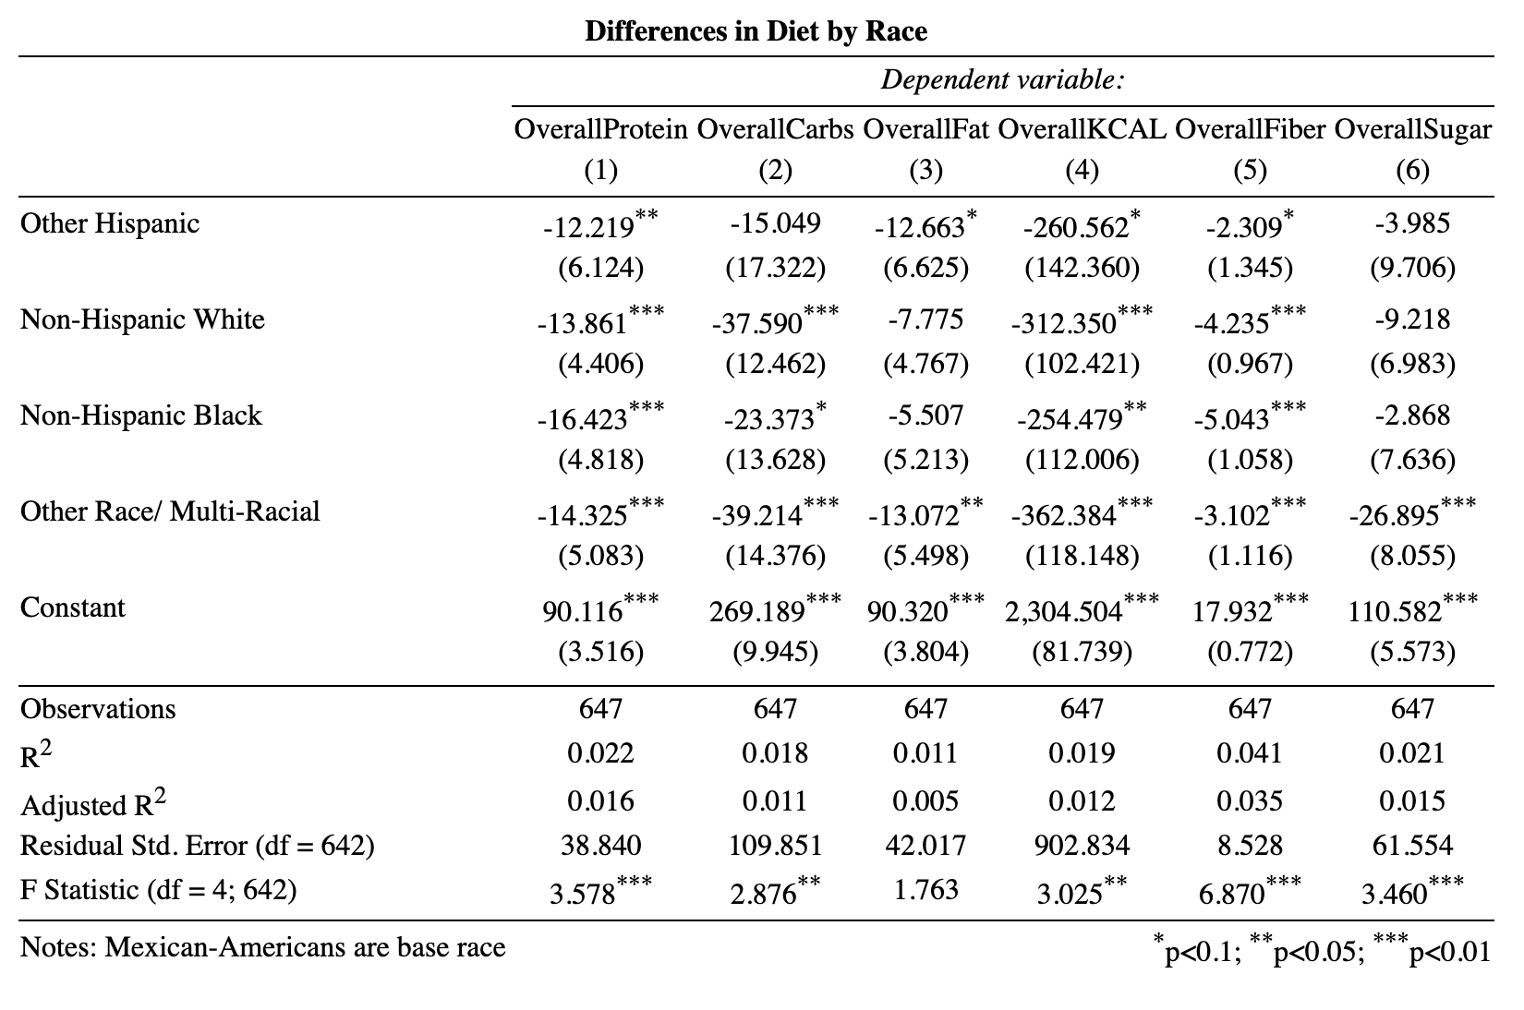
Notes:
Looking at the results from the model, we see the largest differences in overall protein and fiber consumption. Note that as before, this model uses Mexican-Americans as the base group.

Slide 16
Notes:
We also see Intermediate level differences in carbohydrate and overall caloric consumption

Slide 17
Notes:
with the fewest differences occurring in fat and sugar consumption.
SKIP: Even though this was one of few models with differences between racial groups, it is important to note that while coefficeints are shown to be significant, racial R^2 is still low for all the models as are the standard deviations/ errors. The lack of strong statistical relationships between ses groups and nutrition suggests that inequities in health may lie in other variables.
It is important to note that, differences in amount of protein, carbs, fat, etc. may be explained by overall caloric intake. As part of the next steps in our analysis we will address this and look into more detail as to possible causes of dietary differences between racial groups.

Slide 18
Physical Activity

Slide 19
Physical Activity
Basic Models run
Broken Down into High, Mid and Low Income groups
Income and physical activity
moderate recreational activity
vigorous recreational activity
day per week active
Just physical activity
Physical activity with BMI and education as cofactors
total time spent exercising
Notes:
Income and physical activity -> dummy variable “moderate physical activity” and days per week spent doing phyisical activity

Slide 20
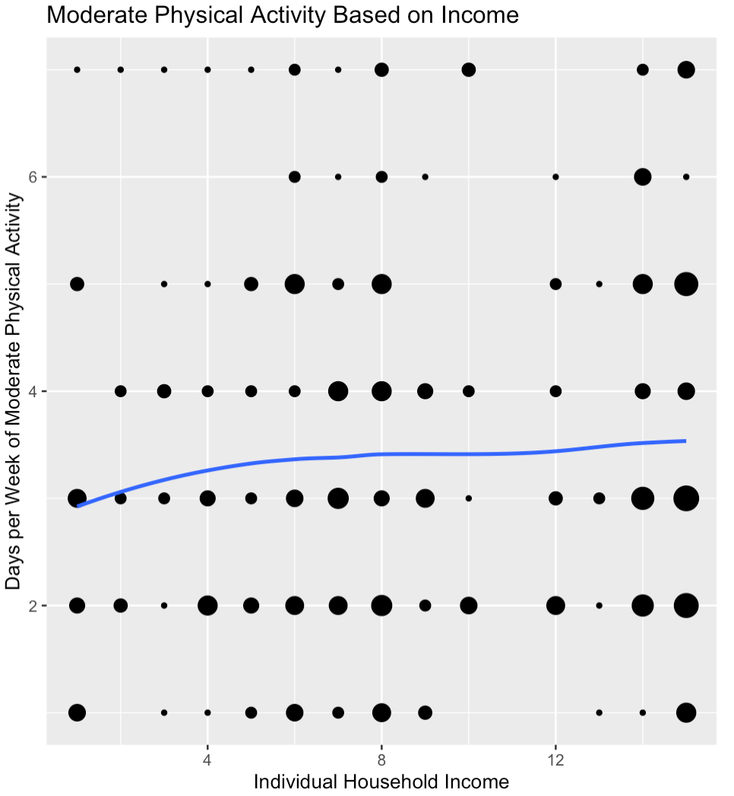
Notes:
Even though this was one of few models with differences between racial groups, it is important to note that while coefficeints are shown to be significant, racial R^2 is still low for all the models as are the standard deviations/ errors. The lack of strong statistical relationships between ses groups and nutrition suggests that inequities in health may lie in other variables.

Slide 21
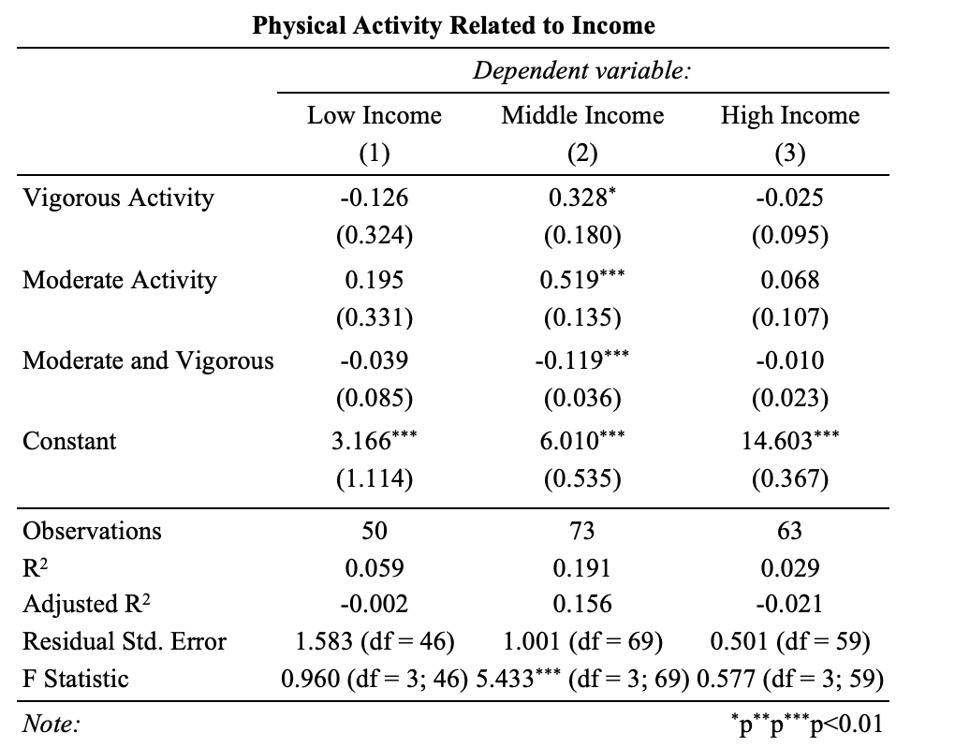
Notes:
Even though this was one of few models with differences between racial groups, it is important to note that while coefficeints are shown to be significant, racial R^2 is still low for all the models as are the standard deviations/ errors. The lack of strong statistical relationships between ses groups and nutrition suggests that inequities in health may lie in other variables.

Slide 22
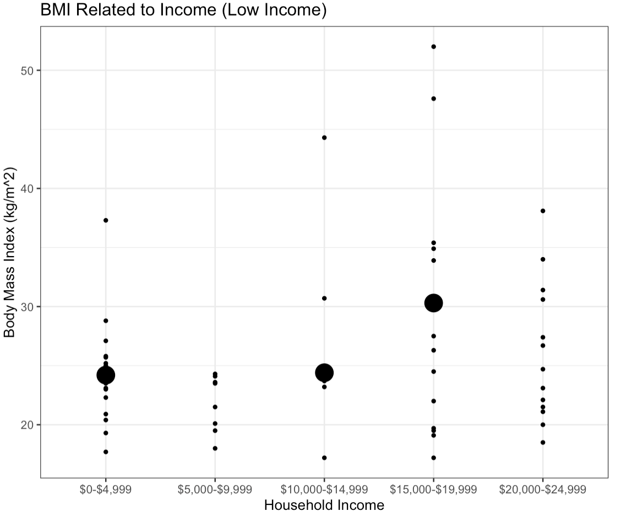
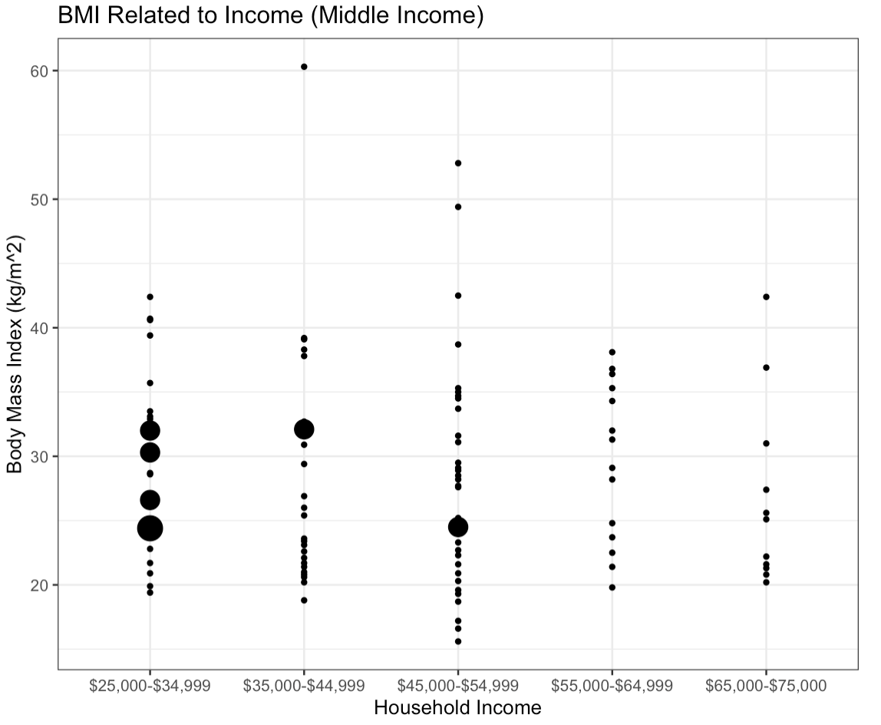
Body Mass Index
Notes:
similar range, but neither shows a significant relationship

Slide 23
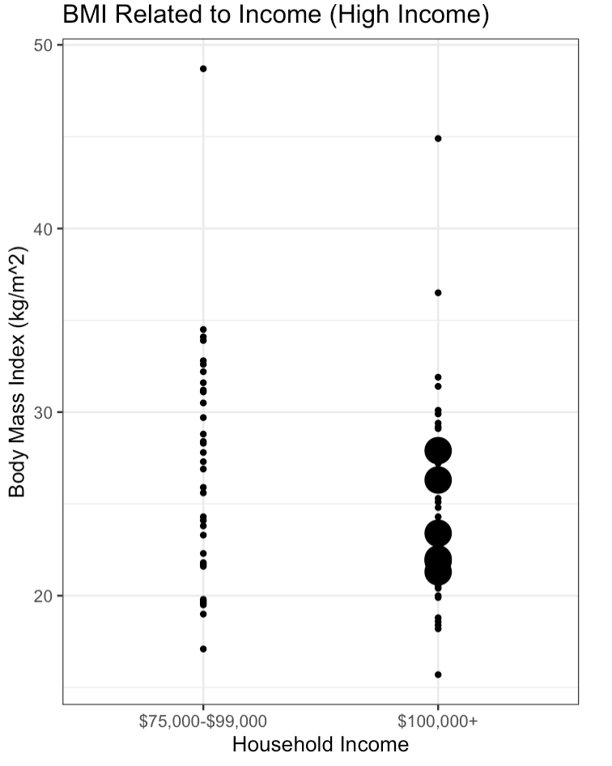

Slide 24
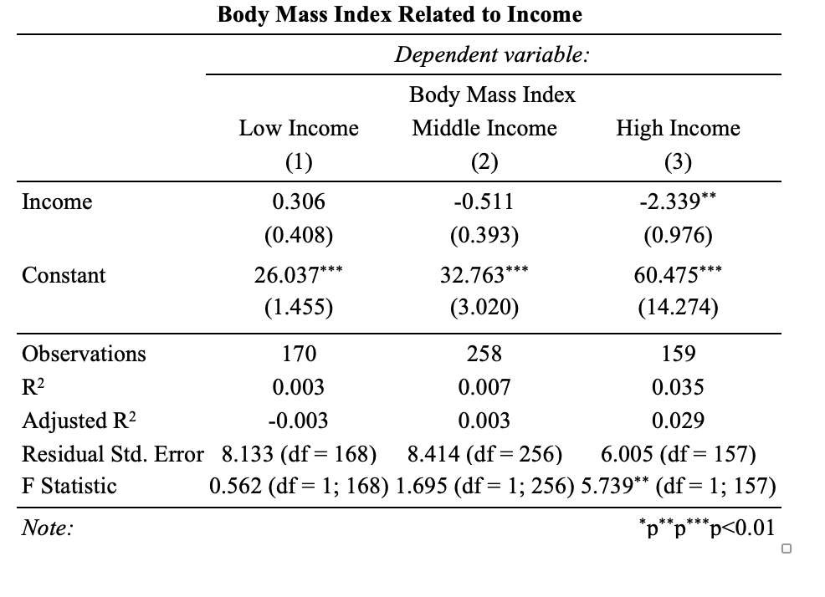

Slide 25
Mental Health
Notes:
The third topic we ran an analysis on is mental health. We wanted to see if there are relationships connecting depression symptoms and substance abuse to income in order to further determine how a healthy life, in general, is related to income.

Slide 26
Depression
Dependent Variable
Independent Variables
Annual Household Income: Total household income (increments of $10,000)
Ratio of Family Income to Poverty: (reported as a number between 0-5)
Depression Total: Score from a depression screening test. A higher score corresponds to a respondent showing more symptoms of depression
Notes:
One of the topics we ran an analysis on is depression
The dependent variables we used are
The independent variables we used are

Slide 27
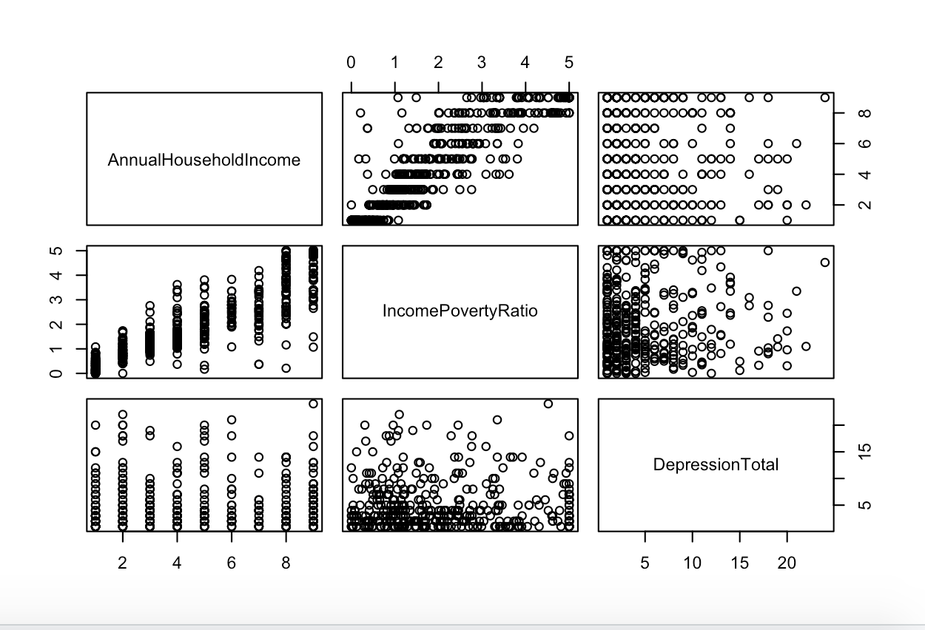
Summary
Notes:
There appears to be a positive relationship between the Income to Poverty Ratio and Annual Household Income, this makes sense because they are measuring the same statistics.
There appears to be a negative relationship between the Income to Poverty Ratio and Depression Total, however it is weak at best.

Slide 28
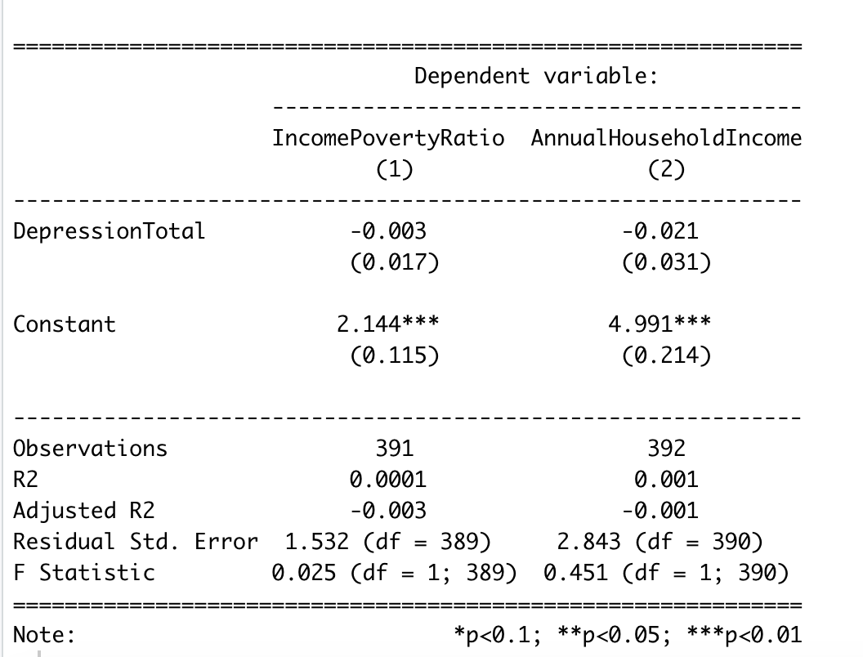
Notes:
Depression was not found to be a significant predictor of the income to poverty ratio nor the annual household income using a linear model regression

Slide 29
Drug Usage
Dependent Variables
Independent Variables
Annual Household Income: Total household income (reported as a range value in dollars)
Ratio of Family Income to Poverty: A ratio of family income to poverty guidelines (reported as a number between 0-5)
Drug Usage Total: Number of drugs a respondent has used in their life out of marijuana, cocaine, methamphetamines, and heroin
Rehab: Has the respondent ever been in a medical rehabilitation program 1 = Yes, 0 = No
Notes:
The other topic we ran an analysis on is Drug Usage in which we used the same dependent variables as we did with Depression.
The independent variables we used are

Slide 30
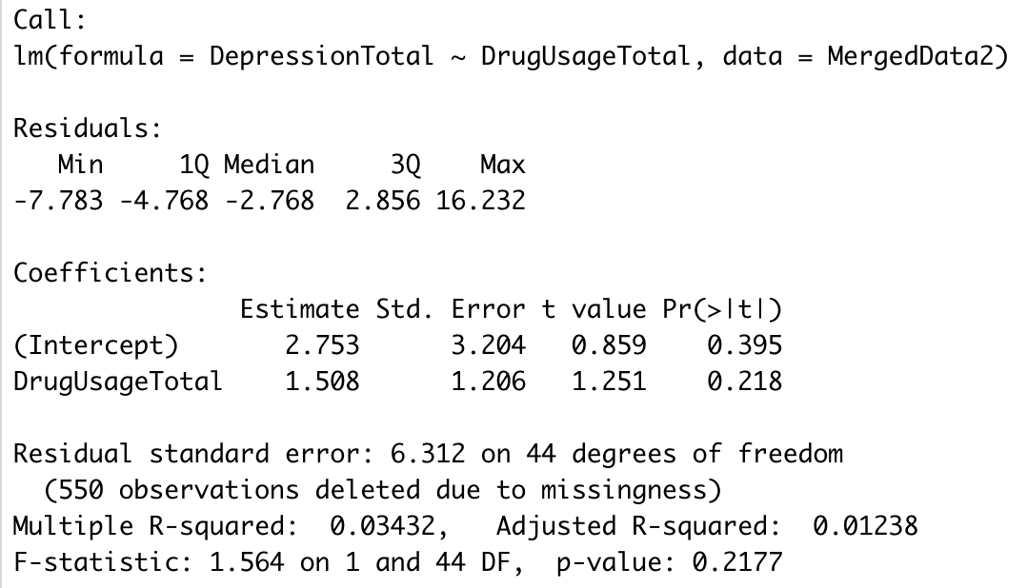
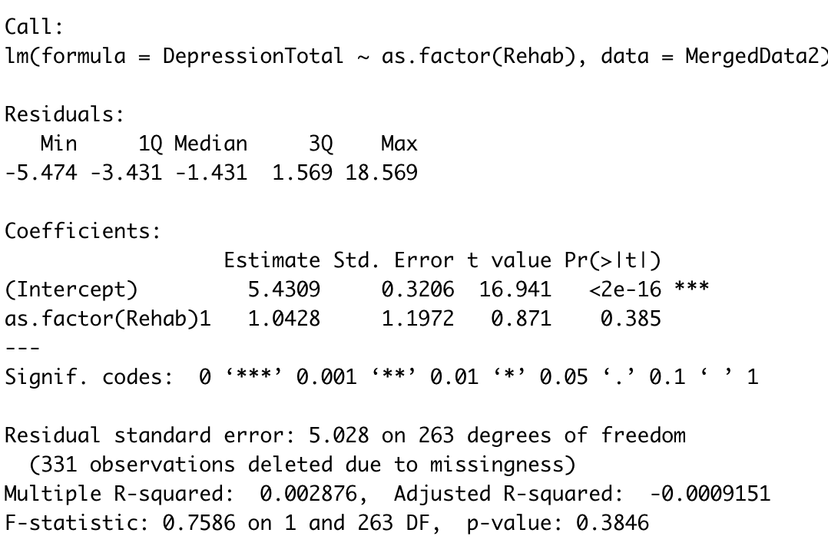
Connection to Mental Health
“...mental health problems are commonly comorbid with substance abuse in the general population”
Booth BM, Walton MA, Barry KL, et al. Substance use, depression and mental health functioning in patients seeking acute medical care in an inner-city ED. J Behav Health Serv
Res. 2011
Notes:
Outside research shows that “mental health problems are commonly comorbid with substance abuse in the general population”. So by analyzing mental health data such as drug usage and rehab attendance we are able to better understand the connection between mental health and income by using more data.

Slide 31
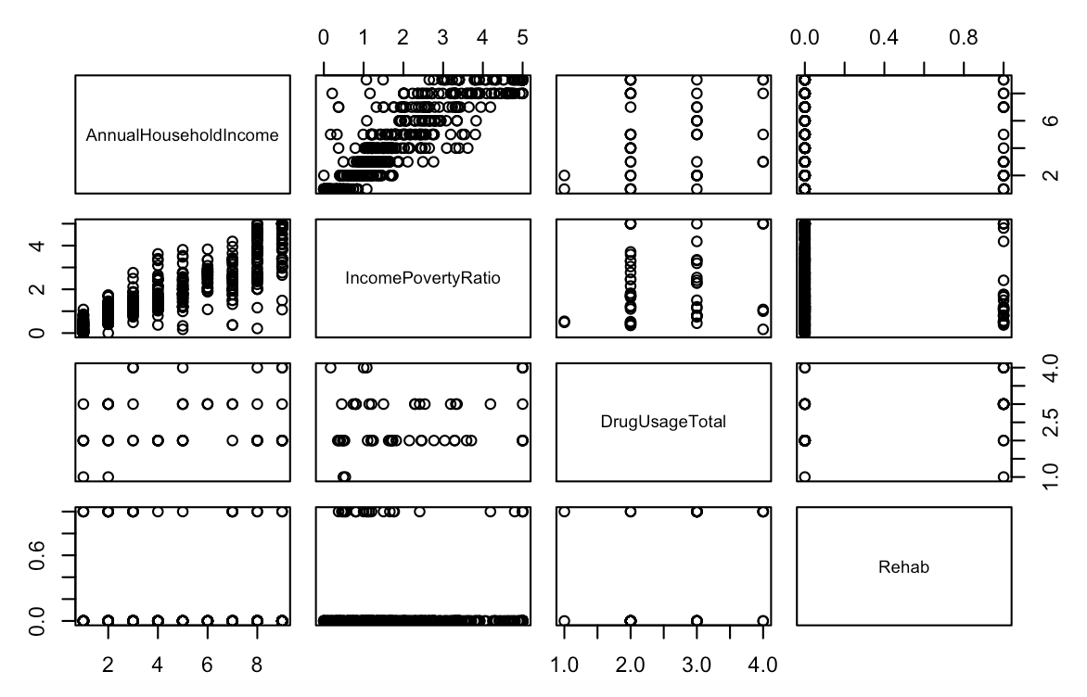
Summary
Notes:
There appears to be a positive relationship between Annual Household Income and Drug Usage, however it is weak at best
There appears to be a negative relationship between the Income Poverty Ratio and Rehab, however it is weak at best

Slide 32
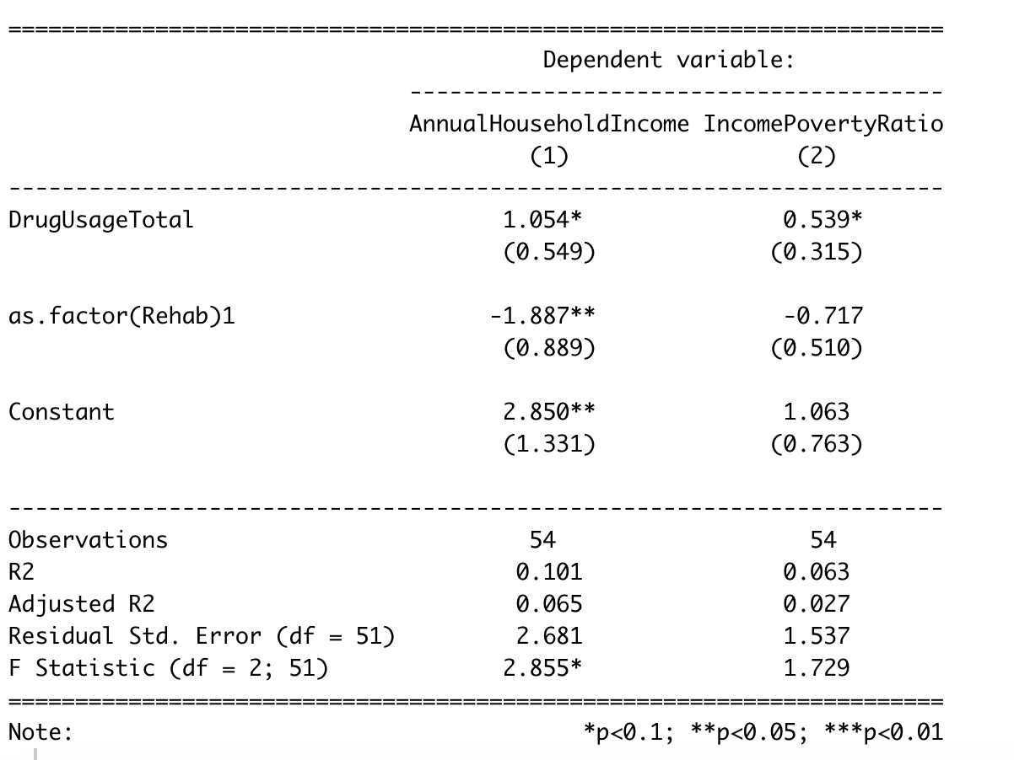
Notes:
using a
There is a significant positive relationship between drug usage and income as well as the income to poverty ratio
There is a significant negative relationship between rehab attendance and income

Slide 33
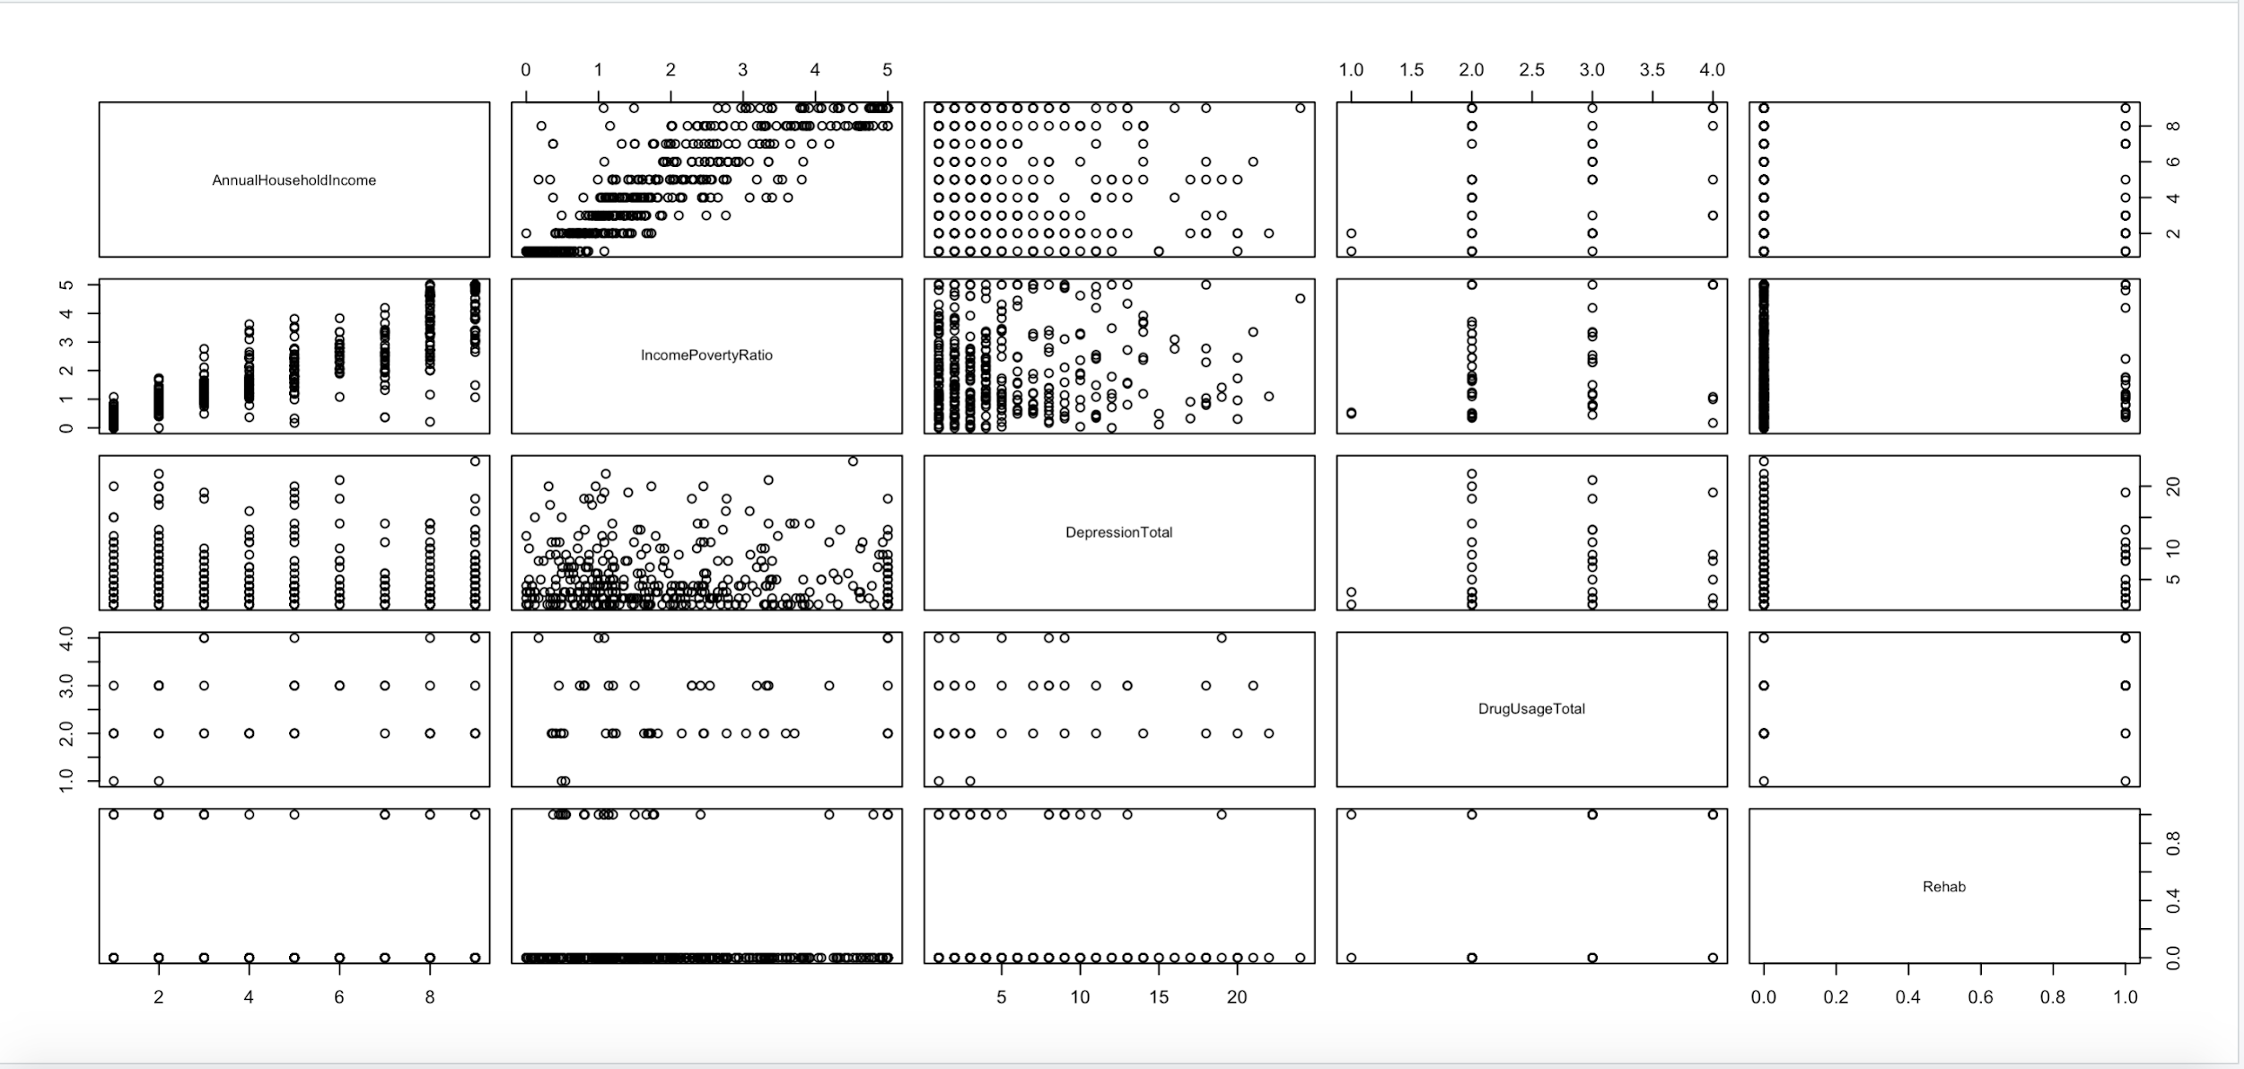
Summary

Slide 34
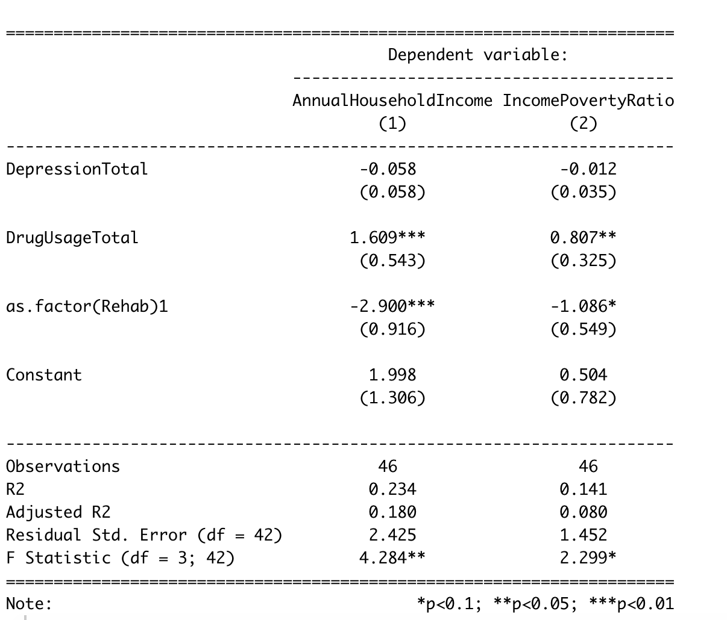
Notes:
A regression of all of the variables shows that there is no significant relationship between depression and income
When all three variable are used to estimate income and income to poverty ratio, rehab attendance and drug usage were more significant predictors than when they were not included with depression
We plan to explore the surprising negative relationship between drug usage and income further on in our project

Slide 35
Limitations

Slide 36
Limitations to Our Findings
Income level highly variable for what may be reported
Used household, but will college-aged kids use their own income or family income?
i.e. income may not be as good an indicator of SES as hoped
Doesn’t separate above $100,000, which is roughly 30% of American families
Income was defined as a range, not a clear value
Many subjective responses
No direct access to other variables
Missing responses from a representative dataset

Slide 37
Conclusions & Next Steps

Slide 38
Conclusions & Recommendations
Data calls for further analysis and study; at this time our models can neither confirm nor deny a relationship between SES and overall health
We will Look for relationships between the three indicators and combinations of them to see if we can find more statistically significant results
Notes:
Socioeconomic Status
because not enough of our variables were significant predictors
We could further pursue longitudinal and observational studies, in observing the participants over time and reducing the possibility for lurking variables we will be able to better determine causality in the relationships.

Slide 39
Thank you!

